Slide 1
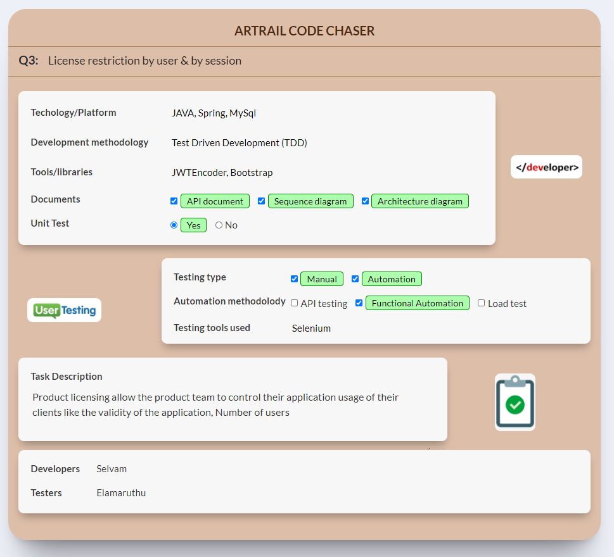

Slide 2
Highlight's
Product licensing allows the product team to define web application usage in terms of.
1) Validity to use the application
2) Number of users can use the application concurrently
3) Maximum number of sessions can be created per user
Since these validations are handled in by extending the spring framework ability it can be reusable with any web app project build using the spring
To ensure the application validity a cron job will be created at system start up to validate application is valid for the day
While user trying to login below mentioned details will be stored
1) IP Address
2) Device type (Mobile or Computer)
3) Browser type and version
4) Operating system of the device
5) Login time
6) Logout time

Slide 3
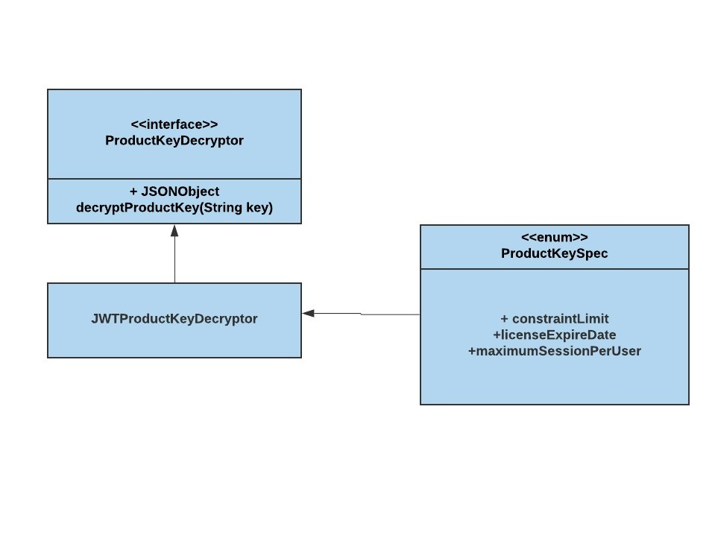
Product key is a JSON formatted values which allow the system to run, it encloses 3 attributes (constraintLimit,licenseExpireDate,maximumSessionPerUser)
In this version we have used JWT as the encryption, but the system is open for using any kind of encryption.
By implementing the ProductKeyDecryptor interface new decryption can be added to the system
And for api authentication currently we used BasicAuth it can also be changed.
Since the encryption and authentications types are open for can be extension, it wont affect the core functionality.

Slide 4
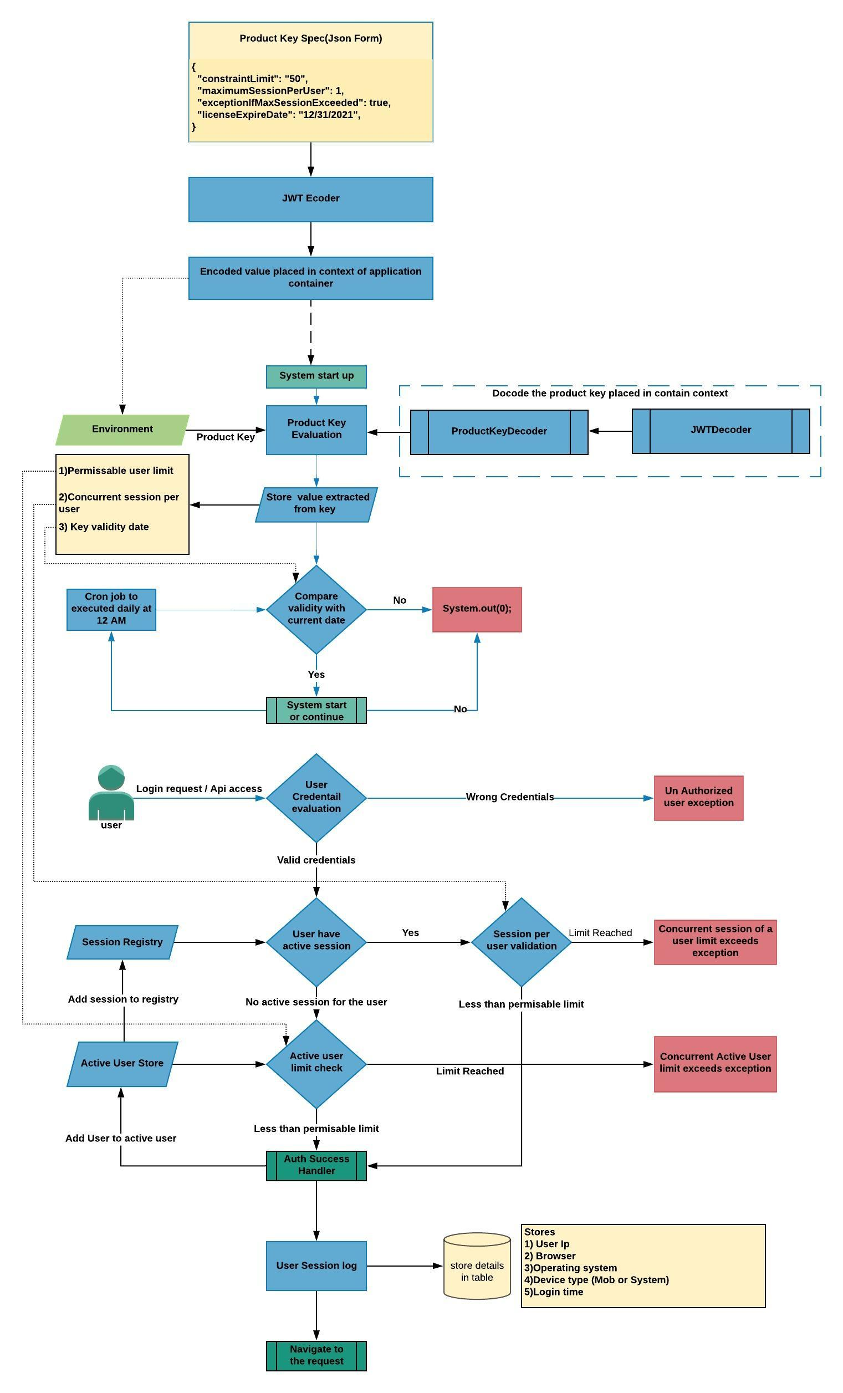
Functional Architecture

Slide 5
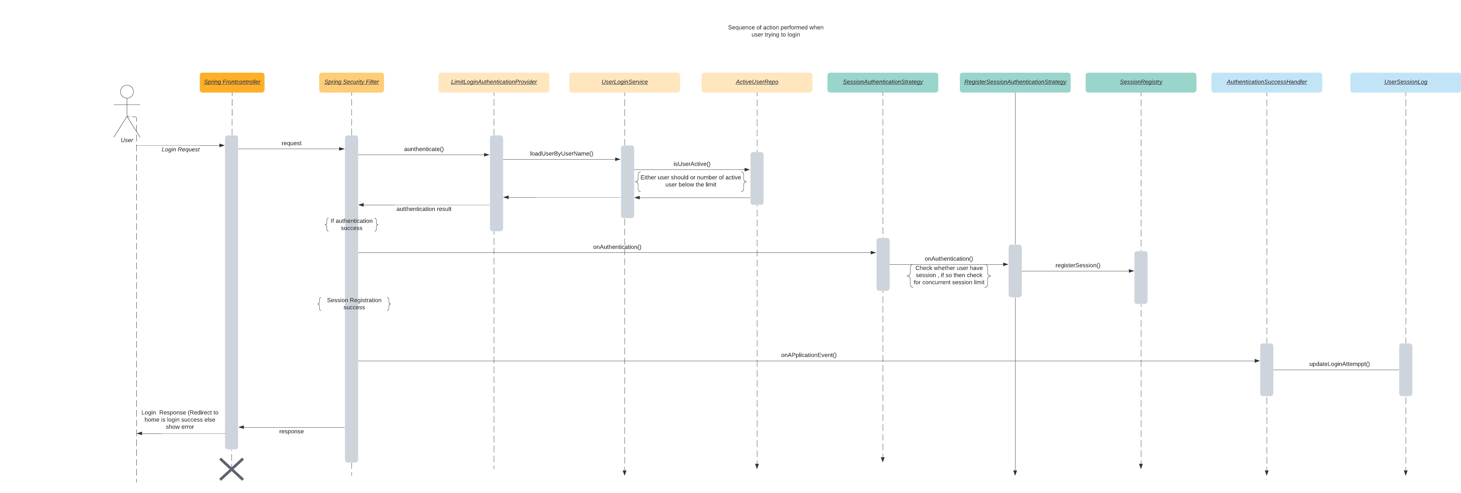
Sequence Diagram

Slide 6
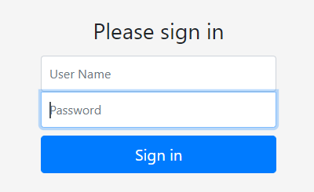
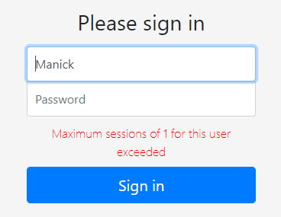
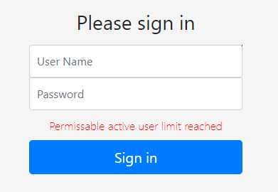
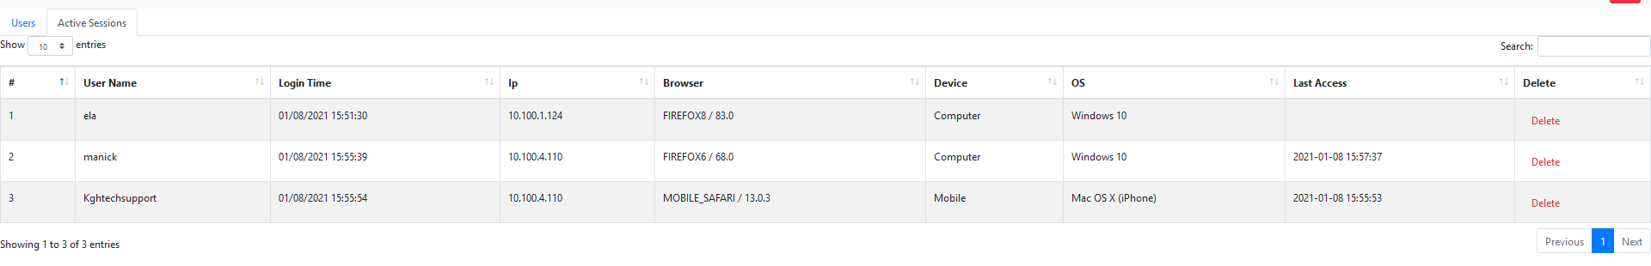
Login
Session Listing

